Slide 1

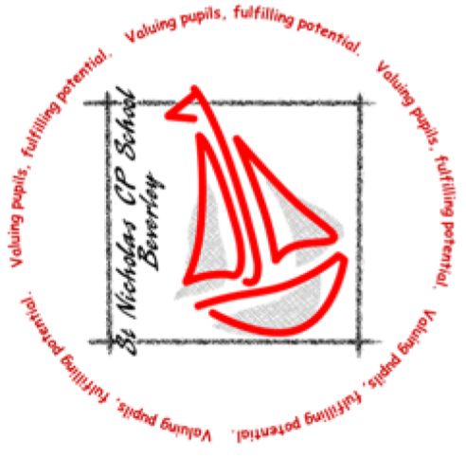

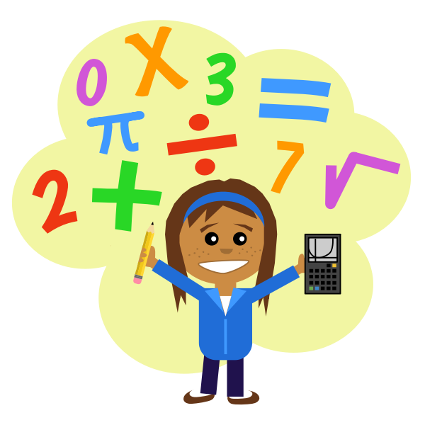



Year 5 & 6 Curriculum Newsletter Spring Term 2026
Writing
In our writing lessons we will be creating a fear story using the tale of Lucy and the Darkness as inspiration. As well as this the children will write an instruction text. This time they will use ‘how to trap a house elf’ as inspiration.
Reading
For our whole class reading this term we are studying the book Journey to Jo’burg by Beverley Naidoo. We will be having lots of discussions regarding the text as well as answering questions about it. It is a modern classic book, which is about sibling love and responsibility set in South Africa.
Maths
In maths this term, we will be building upon our knowledge of fractions, decimals, area and perimeter. Year sixes will also learn about basic algebra.
As always, there will be lots of practise of times tables as knowing these is beneficial to all areas of the maths curriculum. We recommend that you continue this at home using TTR or just oral practice.
Message from your teachers
Welcome back - we hope you have had a wonderful break, and are ready to come back refreshed and ready to learn!.
This newsletter provides you with some useful information about the areas that our Year 5 & 6 children will be covering over the coming few weeks. We have a busy term ahead! If you have any concerns or queries please do not hesitate to contact your child’s class teacher either via email or at the end of the school day. Many thanks.
Miss Booth, Mr Horsley, Mrs Raisin and Mr Walker
Computing
In computing this term, children will be looking at creating their own webpage. The children will look at a variety of different websites and analysing them. Children will then have a chance to design their own.
Home Learning
All home learning is now set on the Doodle Learning website. The tasks are set by your class teacher, but are suited to the child’s level - please do not give too much support on this, as this may make the work harder than it should be!
We also expect children to be reading for pleasure at home as much as possible, preferably a minimum of 3 times per week. This does not need to be recorded, but will benefit them significantly academically. Pupils also have access to the Reading Plus website.
Religious Education
The theme within RE lessons this half term is ‘Living a Faith’. Within this we will explore our sense of identity, and think about how different people of different religions live in a way that reflects their believes.
After half term we will be learning about Easter, learning about what Christians believe in terms of the Easter story, and the meaning of Easter celebrations.

Slide 2

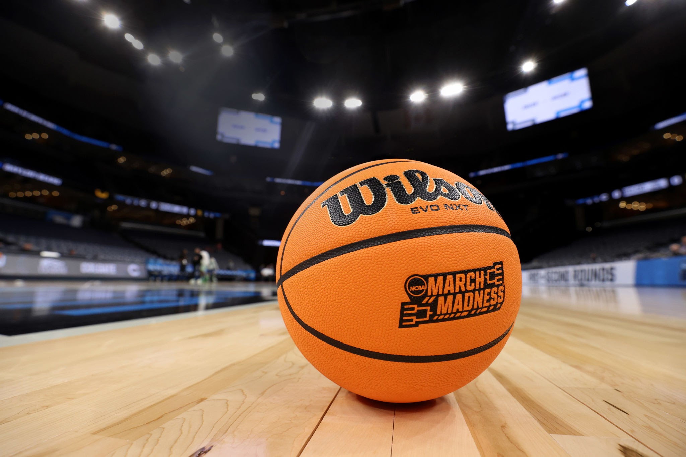


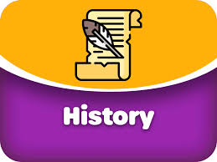
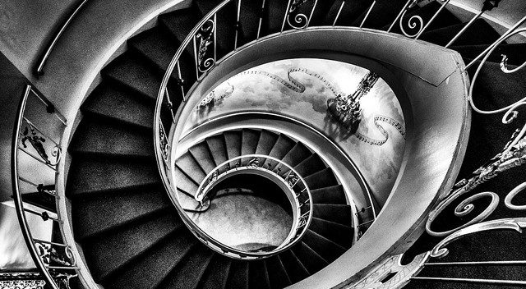

PE
.
In our outdoor sessions we will be looking at tennis. We will be building our skills from previous years.
Our indoor PE will be dance - with a focus on children using dance to tell the story of their school life.
Please note: any child with hair longer than chin length will need to tie up their hair for PE sessions and will need to remove earrings.
Science
We will start Science in 2026 by learning about the human body, in particular blood, circulation, blood vessels and valves.
In the second half term we will move on to the lifecycle of plants and animals, including mammals, amphibians, insects and birds.
All our science learning is based around careful observations, making predictions, and planning investigations to test these.
French
In French year fives will be learning about fruit and vegetables, and how to buy these in a market in french. Year sixes will be thinking about sport, and using the word ‘jouer’ which meant ‘to play’.
We will be continuing to learning this through our MFL scheme: Primary Languages Network. Please see the MFL Knowledge Organisers on the school website if you would like to practise what we are learning in school.
.
History
In history, we will be focusing on the Maya Civilisation. The Mayans were an extremely sophisticated civilisation who lived around 1500BC to around 910AD. They lived in what is now central America and Mexico. The jungle and mountainous terrain made it hard to grow crops so they learned how to use terraces to grow food. Examples of this can be seen today at Chichen Itza, which still stands in Mexico and is considered one of the 7 wonders of the world. They believed in the afterlife and practised human sacrifice. Mayans are famous for being expert builders, using glyphs to write and also for their calendar system to help track time. We also have them to thank for chocolate!
Art
Our focus this term will be painting. We will be looking at the artist M.C. Escher and using his art work as inspiration for creating our own piece of work. In this study, children will be looking at different painting techniques using water colours.
Music
This term we will be learning about the grime genre of music. We will think about the origin of the music style, and will be using technology to create our own grime music.
Children will continue to access their peripatetic music lessons alongside this: piano, woodwind, drums, guitar and violin.

Slide 3
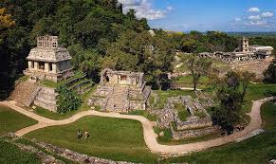
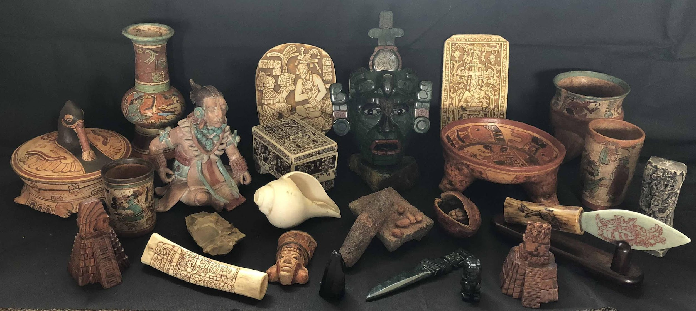
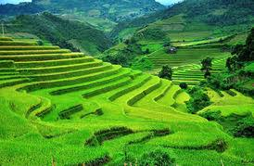
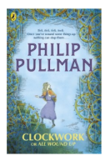
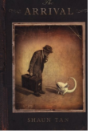
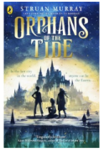
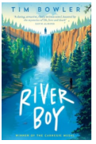
Learning in our theme – The Ancient Maya
Subject specific vocabulary
Empire | A group of states or countries ruled over by a single monarch
Glyphs | Symbols used in the Mayan writing system. Each symbol represents a word or sound.
City - states | An independent city with a king. A city-state is not in a state or a country. The Mayans civilization did not have one central government.
Astronomical observatories | From a fixed observation station, Maya astronomers tracked the position of the moon, planets, Milky Way and the sun.
Codex | A codex is an ancient book that is made of sheets of parchment, vellum, papyrus, or other materials, and is bound together. It is the ancestor of the modern book.
After - life | The afterlife is a belief in a continued existence of consciousness or identity after one's physical body has died.
Stelae | Stelae are tall, carved stone monuments.
Irrigation | The ancient Maya built a sophisticated rainwater collection system. This system supplied inhabitants with enough water for several months.
Terrace | This is where walls are built to make small flat fields one on top of the other.
Knowledge and Facts
The Maya were excellent builders and did not use metal tools or wheels to build their cities.
They had their own writing system made of pictures and symbols called glyphs.
The Maya loved maths and were one of the first people to use the number zero.
They created calendars to track days, months, and even the movement of stars. The Maya studied the sun, moon, and stars and were amazing astronomers.
Most Maya people were farmers who grew crops like corn, beans, and squash.
Chocolate was very important to the Maya, and they made drinks from cocoa beans!
They played a famous ball game using a rubber ball and stone courts.
The Maya believed in many gods and told stories about how the world was made.
Maya people still live today and many keep their traditions and languages alive.
Reading Spine Books

Slide 4
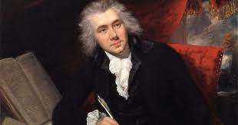
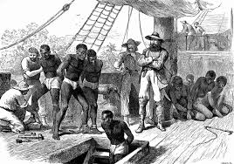
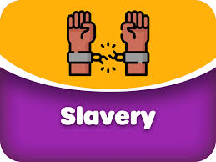
Learning in our theme – Wiiliam Wilberforce
Subject specific vocabulary
Slave | A slave is classed as property of another person, with no freedom of choice and no money. That person is ‘owned’ by someone else.
Slavery | Slavery refers to a condition in which individuals are owned by others, who control where they live and at what they work.
Transatlantic trade | The three‐part Transatlantic slave trade that involved taking goods from Britain to Africa to exchange for people. Those people were then taken to America to work as slaves and exchanged for goods which were sold in Britain and Europe
Auction | A public sale where goods are sold to the highest bidder.
Plantation | An estate on which crops, such as coffee, sugar and tobacco are grown
Middle Passage | The journey across the Atlantic Ocean that captured Africans were taken on, ocean in unsanitary conditions.
Abolition | The act of abolishing a system so that it is no longer permitted
William Wilberforce | He was a British politician and a leader of the movement to abolish the slave trade.
Knowledge and Facts
William Wilberforce was born in 1759 in England, over 250 years ago.
He grew up to become a Member of Parliament, helping make laws for the country.
William believed that slavery was wrong and that all people should be treated fairly.
He spent many years trying to end the slave trade, even when it was very difficult.
Lots of people told him to stop, but he never gave up.
William worked with friends who also wanted to help others, showing that teamwork matters.
In 1807, the slave trade was made illegal in Britain because of his hard work.
William was known for being kind, caring, and brave.
He believed that one person can make a big difference.
William Wilberforce is remembered today as a hero who helped change history.
Reading Spine Books

